Slide 1
Richard Johnson
ToorCon San Diego 2016

Slide 2
Go Speed Tracer

Slide 3
Introduction
Richard Johnson
Research Manager
Cisco Talos
Team
Aleksandar Nikolich
Ali Rizvi-Santiago
Marcin Noga
Piotr Bania
Tyler Bohan
Yves Younan
Special Contributor
Andrea Allevi
Talos Vulndev
Third party vulnerability research
170 bug finds in last 12 months
Microsoft
Apple
Oracle
Adobe
Google
IBM, HP, Intel
7zip, libarchive, NTP
Security tool development
Fuzzers, Crash Triage
Mitigation development
FreeSentry

Slide 4
Introduction
Agenda
Tracing Applications
Guided Fuzzing
Binary Translation
Hardware Tracing
Goals
Understand the attributes required for optimal guided fuzzing
Identify areas that can be optimized today
Deliver performant and reusable tracing engines

Slide 5
Applications
Software Engineering
Performance Monitoring
Unit Testing
Malware Analysis
Unpacking
Runtime behavior
Sandboxing
Mitigations
Shadow Stacks
Memory Safety checkers

Slide 6
Applications
Software Security
Corpus distillation
Minimal set of inputs to reach desired conditions
Guided fuzzing
Automated refinement / genetic mutation
Crash analysis
Crash bucketing
Graph slicing
Root cause determination
Interactive Debugging

Slide 7
Tracing Engines
OS Provided APIs
Debuggers
ptrace
dbgeng
signals
Hook points
Linux LTT(ng)
Linux perf
Windows Nirvana
Windows AppVerifier
Windows Shim Engine
Performance counters
Linux perf
Windows PDH
Check out Alex Ionescu’s
RECON 2015 talk

Slide 8
Tracing Engines
Binary Instrumentation
Compiler plugins
gcc-gcov
llvm-cov
Binary translation
Valgrind
DynamoRIO
Pin
DynInst
Frida and others
...

Slide 9
Tracing Engines
Native Hardware Support
Single Step / Breakpoint
Intel Branch Trace Flag
Intel Last Branch Record
Intel Branch Trace Store
Intel Processor Trace
ARM CoreSight

Slide 10
Guided Fuzzing

Slide 11
Evolutionary Testing
Early work was whitebox testing
Source code allowed graph analysis prior to testing
Fitness based on distance from defined target
Complex fitness landscape
Difficult to define properties that will get from A to B
Applications were not security specific
Safety critical system DoS

Slide 12
Guided Fuzzing
Incrementally better mutational dumb fuzzing
Trace while fuzzing and provide feedback signal
Evolutionary algorithms
Assess fitness of current input
Manage a pool of possible inputs
Focused on security bugs

Slide 13
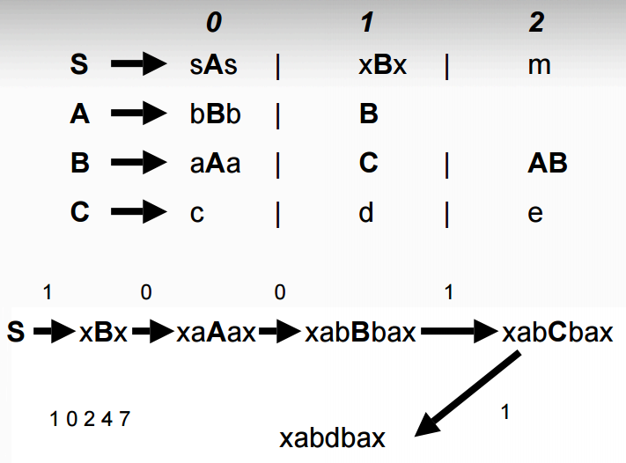
Sidewinder
Embleton, Sparks, Cunningham 2006
Features
Simple genetic algorithm approach
crossover, mutation, fitness
Mutated context free grammar
instead of sample fuzzing
Markov process for fitness
Analyzes probability of path taken by sample
Block coverage via debugger API
Reduced overhead by focusing on subgraphs

Slide 14
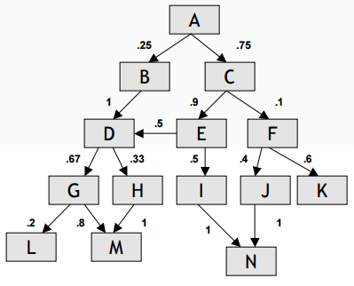
Sidewinder
Embleton, Sparks, Cunningham 2006
Contributions
Genetic algorithms for fuzzing
Markov process for fitness
System allows selection of target code locations
Observations
Never opensourced
Interesting concepts not duplicated

Slide 15
Evolutionary Fuzzing System
Jared DeMott 2007
Features
Block coverage via Process Stalker
Windows Debug API
Intel BTF
Stored trace results in SQL database
Lots of variables required structured storage
Traditional genetic programming techniques
Code coverage + diversity for fitness
Sessions
Pools
Crossover
Mutation

Slide 16
Evolutionary Fuzzing System
Jared DeMott 2007
Contributions
First opensource implementation of guided fuzzing
Evaluated function vs block tracing
For large programs found function tracing was equally effective
Likely an artifact of doing text based protocols
Observations
Academic
Approach was too closely tied to traditional genetic algorithms
Not enough attention to performance or real world targets
Only targeted text protocols

Slide 17
Amercian Fuzzy Lop
Michal Zalewski 2013
Bunny The Fuzzer 2007
Features
Block coverage via compile time instrumentation
Simplified approach to genetic algorithm
Edge transitions are encoded as tuple and tracked in global map
Includes coverage and frequency
Uses variety of traditional mutation fuzzing strategies
Dictionaries of tokens/constants
First practical high performance guided fuzzer
Helper tools for minimizing test cases and corpus
Attempts to be idiot proof

Slide 18
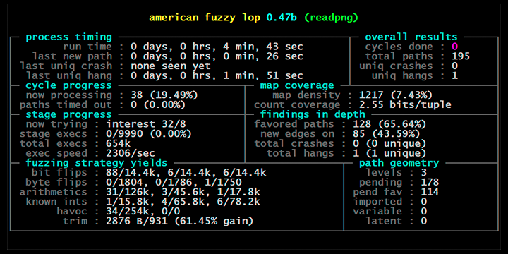
Amercian Fuzzy Lop
Michal Zalewski 2013
Bunny The Fuzzer 2007
Contributions
Tracks edge transitions
Not just block entry
Global coverage map
Generation tracking
Fork server
Reduce fuzz target initialization
Persistent mode fuzzing
Builds corpus of unique inputs reusable in other workflows

Slide 19
Amercian Fuzzy Lop
Michal Zalewski 2013
Bunny The Fuzzer 2007
Observations
KISS works when applied to guided fuzzing
Performance top level priority in design
Source instrumentation can't be beat
Evolutionary system hard to beat without greatly increasing complexity / cost
Simple to use, finds tons of bugs
Fostered a user community
Developer contributions somewhat difficult
Current state of the art due to good engineering and feature set
Only mutational fuzzer system to have many third-party contributions
Binary support via QEMU and Dyninst
More robust compiler instrumentations, ASAN support
Parallelization, client/server targeting

Slide 20
honggfuzz
Robert Swiecki 2010
Guided fuzzing added in 2015
Features
Block coverage
Hardware performance counters
ASanCoverage
Bloom filter for trace recording
User-supplied mutation functions
Linux, FreeBSD, OSX, Cygwin support
Contributions
First guided fuzzer to focus on hardware tracing support
Observations
Naive seed selection for most algorithms, only the elite survive (OTTES)
Some modes use bloom filter
Easy to extend, active development

Slide 21
Choronzon
Features
Brings back specific genetic programming concepts
Contains strategies for dealing with high level input structure
Chunk based
Hierarchical
Containers
Format aware serialization functionality
Uses DBI engines for block coverage (PIN / DynamoRIO)
Attempts to be cross-platform
Contributions
Reintroduction of more complex genetic algorithms
Robust handling of complex inputs through user supplied serialization routines
Observations
Performance not a focus

Slide 22
Honorable mentions
autodafe
Martin Vuagnoux 2004
First generation guided fuzzer using pattern matching via API hooks
Blind Code Coverage Fuzzer
Joxean Koret 2014
Uses off-the-shelf components to assemble a guided fuzzer
radamsa, zzuf, custom mutators
drcov, COSEINC RunTracer for coverage
covFuzz
Atte Kettunen 2015
Simple node.js server for guided fuzzing
custom fuzzers, ASanCoverage

Slide 23
Guided Fuzzing
Required
Fast tracing engine
Block based granularity
Fast logging
Memory resident coverage map
Fast evolutionary algorithm
Minimum of global population map, pool diversity
Desired
Portable
Easy to use
Helper tools
Grammar detection
AFL and Honggfuzz still most practical options

Slide 24
Binary Translation

Slide 25
Binary Translation
Binary translation is a robust program modification technique
JIT for hardware ISAs
General overview is straightforward
Copy code to cache for translation
Insert instructions to modify original binary
Link blocks into traces
Performance comes from smart trace creation
Originally profiling locations for hot trace
Early optimizations in Dynamo from HP
Next Executing Tail
Traces begin at backedge or other trace exit
Ongoing optimization work happens here
VMware - Early Exit guided

Slide 26
Binary Translation
Advantages
Supported on most mainstream OS/archs
Can be faster than hardware tracing
Can easily be targeted at certain parts of code
Can be tuned for specific applications
Disadvantages
Performance overhead
Introduces additional context switch
ISA compatibility not guarenteed
Not always robust against detection or escape

Slide 27
Valgrind
Obligatory slide
Lots of deep inspection tools
VEX IR is well suited for security applications
Slow and Linux only, DynamoRIO good replacement
Many cool tools already exist
Flayer
Memgrind

Slide 28
Pin
“DBT with training wheels”
Features
Trace granularity instrumentation
Begin at branch targets, end at indirect branch
Block/instruction level hooking supported
Higher level C++ API w/ helper routines
Closed source
Observations
Delaying instrumentation until trace generation is slower
Seems most popular with casual adventurers
Limited inlining support
Less tuning options
Cannot observe blocks added to cache so ‘hit trace’ not possible

Slide 29
Pin
Example
VOID Trace(TRACE trace, VOID *v)
{
for (BBL bbl = TRACE_BblHead(trace); BBL_Valid(bbl); bbl
= BBL_Next(bbl))
{
BBL_InsertCall(bbl, IPOINT_ANYWHERE, AFUNPTR(basic_block_hook),
IARG_FAST_ANALYSIS_CALL, IARG_END);
}
}

Slide 30
DynamoRIO
“A connoisseur's DBT”
Features
Block level instrumentation
Blocks are directly copied into code cache
Direct modification of IL possible
Portable
Linux, Windows, Android
x86/x64, ARM
C API / BSD Licensed (since 2009)
Observations
Much more flexible for block level instrumentation
Performance is a priority, Windows is a priority
Powerful tools like Dr Memory
Shadow memory, taint tracking
Twice as fast as Valgrind memcheck

Slide 31
DynamoRIO
Example
event_basic_block(void *drcontext, void *tag, instrlist_t *bb,
bool for_trace, bool translating)
{
instr_t *instr, *first = instrlist_first(bb);
uint flags;
/* Our inc can go anywhere, so find a spot where flags are dead. */
for (instr = first; instr != NULL; instr = instr_get_next(instr))
{
flags = instr_get_arith_flags(instr);
/* OP_inc doesn't write CF but not worth distinguishing */
if (TESTALL(EFLAGS_WRITE_6, flags) && !TESTANY(EFLAGS_READ_6,
flags))
break;
}
…

Slide 32
DynamoRIO
Example
if (instr == NULL)
dr_save_arith_flags(drcontext, bb, first, SPILL_SLOT_1);
instrlist_meta_preinsert(bb,
(instr == NULL) ? first : instr,
INSTR_CREATE_inc(drcontext,
OPND_CREATE_ABSMEM((byte *)&global_count, OPSZ_4)));
if (instr == NULL)
dr_restore_arith_flags(drcontext, bb, first, SPILL_SLOT_1);
return DR_EMIT_DEFAULT;
}

Slide 33
DynInst
“Static rewriting IS possible!”
Features
Static rewriting support
Dynamically linked binaries only
Eliminates issues with instruction cache misses common to DBT engines
Function level analysis
Tools must manually walk Dyninst provided CFG to instrument blocks
Modular C++ API / LGPL
Observations
Fastest binary instrumentation out there
Development is slow
Patches we sent in for PE relocation support still not merged
Building Dyninst is NP-Hard
Use my Dockerfile on github.com/talos-vulndev/afl-dyninst

Slide 34
DynInst
Example
bool insertBBCallback(BPatch_binaryEdit * appBin, BPatch_function * curFunc,
char *funcName, BPatch_function * instBBIncFunc,int *bbIndex)
{
unsigned short randID;
BPatch_flowGraph *appCFG = curFunc->getCFG ();
BPatch_Set <BPatch_basicBlock *> allBlocks;
BPatch_Set <BPatch_basicBlock *>::iterator iter;
for (iter = allBlocks.begin (); iter != allBlocks.end (); iter++)
{
unsigned long address = (*iter)->getStartAddress ();
randID = rand() % USHRT_MAX;
BPatch_Vector <BPatch_snippet *> instArgs;
BPatch_constExpr bbId (randID);
instArgs.push_back (&bbId);
…

Slide 35
DynInst
Example
…
BPatch_point *bbEntry = (*iter)->findEntryPoint();
BPatch_funcCallExpr instIncExpr (*instBBIncFunc, instArgs);
BPatchSnippetHandle *handle =
appBin->insertSnippet (instIncExpr, *bbEntry, BPatch_callBefore,
BPatch_lastSnippet);
(*bbIndex)++;
}
return true;
}

Slide 36
Tuning Binary Translation
Only instrument indirect branches
Delay instrumentation until input is seen
Only instrument threads that access the data
Move instrumentation logic to analysis routines
Some APIs provide IF-THEN-ELSE analysis with optimization
Avoid trampolines
Be aware of code locality and instruction cache
Directly inline instructions, modify AST if possible
Inject a fork server if repeatedly executing DBT
See our turbotrace tool

Slide 37
Hardware Tracing

Slide 38
CPU Event Monitoring
Modern CPUs contain Performance Monitoring Units (PMU)
Model Specific Registers (MSR) used for configuration
Requires privileged execution (kernel or better) to access
Types
Event Counters
Polled on-demand
Event Sampling (non-precise)
Interrupts triggered when counters hit modulus value
Precise Event Sampling (PEBS)
Uses 'Debug Store'
Physical memory buffers
Interrupt when full
Use Linux perf / pmu-tools to experiment

Slide 39
Interrupt Programming
Interrupts - low level messaging system for system devices
CPU Exceptions
GPF, SINGLE_STEP
Hardware Interrupts
Memory mapped or IRQ based
All Device I/O
Software Interrupts
System calls (int 0x80)
Breakpoints
OS/hypervisor drivers required to configure interrupt handlers
Privileged registers or interrupt vector tables

Slide 40
Interrupt Programming
Interrupt Service Routines (ISR)
Registered by operating systems and drivers as callbacks
CPU checks interrupt flag (IF) register after each instruction
cli and sti instructions control whether IF is checked
CPU indexes the interrupt vector table to find appropriate handler
Context stored / restored while servicing interrupt
Historically Familiar Interrupts:
int 1 - Single Step (TF)
int 3 - Single opcode, specifically designed for debugging
int 10h - Any Demosceners?
int 24h - DOS Critical Error Handler
Who remembers:
I/O Device Specific Error Message
Abort, Retry, Ignore, Fail?

Slide 41
Interrupt Programming
Programmer checklist
Memory must not be swapped
Use static variables if necessary
Must wrap functions with assembly
disable interrupts
push all registers
call interrupt handler
pop all registers
iretd

Slide 42
Its a Trap
Single Stepping
Enabled by setting the Trap Flag
After each instruction, CPU checks flag and fires exception if enabled
Accessible from userspace
Branch Trace Flag
Modifies single step behavior to trap on branch
Single flag in IA32_DEBUGCTL MSR
Requires kernel privileges to write to MSR
Windows includes a mapping from DR7 to set MSR
SS/BTF traps are slooooooooow, not applicable for vulnerability research

Slide 43
IA32_DEBUGCTL Register
MSR Address 0x1d9
LBR [0] - Enable Last Branch Record mechanism
BTF [1] - when enabled with TF in EFLAGS does single stepping on branches
TR [6] - enables Tracing (sending BTMs to system bus)
BTS [7] - enables sending BTMs to memory buffer from system bus
BTINT [8] - full buffer generates interrupt otherwise circular write
BTS_OFF_OS [9] - does not count for priv. level 0
BTS_OFF_USR [10] - does not count for priv. level 1,2,3
FRZ_LBRS_ON_PMI [11] - freeze LBR stack on a PMI
FRZ_PERFMON_ON_PMI [12] - disable all performance counters on a PMI
UNCORE_PMI_EN [13] - uncore counter interrupt generation
SMM_FRZ [14] - event counters are frozen during SMM

Slide 44
Branch Trace Store
First generation hardware branch tracing via PMU
Allows configurable memory buffer for trace storage
MSR_IA32_DS_AREA MSR defines storage location
DS_AREA_RECORD stored for each branch
struct DS_AREA {
u64 bts_buffer_base;
u64 bts_index;
u64 bts_absolute_maximum;
u64 bts_interrupt_threshold;
u64 pebs_buffer_base;
u64 pebs_index;
u64 pebs_absolute_maximum;
u64 pebs_interrupt_threshold;
u64 pebs_event_reset[4];
};
struct DS_AREA_RECORD {
u64 flags;
u64 ip;
u64 regs[16];
u64 status;
u64 dla;
u64 dse;
u64 lat;
};

Slide 45
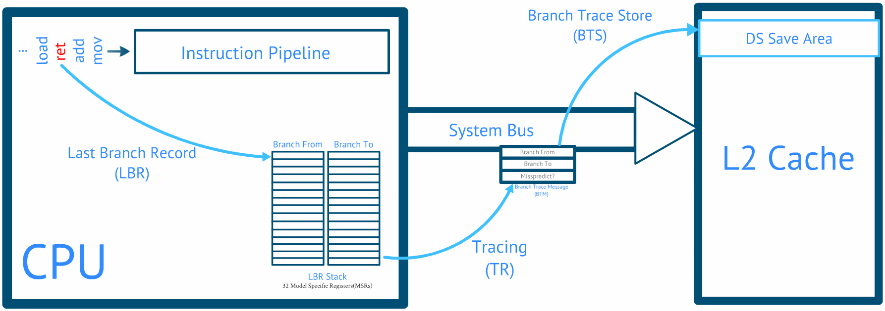
Branch Trace Store

Slide 46
Branch Trace Store
Branches in LBR registers spill to DS_AREA
Interrupts only when buffer is full
Steps to enable BTS
Allocate memory and set MSR_IA32_DS_AREA
Add interrupt handler to IDT
Register interrupt vector with APIC
apic_write(APIC_LVTPC, pebs_vector);
Select events with MSR_IA32_EVNTSEL0
EVTSEL_EN | EVTSEL_USR | EVTSEL_OS
Enable PEBS mode with MSR_IA32_PEBS_ENABLE
Enable CPU perf recording with MSR_IA32_GLOBAL_CTRL
Significantly faster than BTF
Still impractical for high speed tracing
Notes:
BTS Demo .. Its slower than PIN/DynamoRIO

Slide 47
Intel Processor Trace
Next generation hardware tracing support
Introduced in Broadwell/Skylake architecture
Per-hardware tracing thread
Goal: full system branch tracing with 5-15% overhead
Software support available in
Linux 4.1+ perf subsystem
Standalone Linux reference driver simple-pt
Intel VTune / System Studio**
Remote debugging only
Talos IntelPT driver!
Windows localhost high speed hardware tracing FTW!

Slide 48
Intel Processor Trace
Features
Can trace *SMM, HyperVisor, Kernel, Userspace [CPL -2 to 3]
Logs directly to physical memory
Bypasses CPU cache and eliminates TLB cache misses
Can be a contiguous segment or a set of ranges
Ringbuffer snapshot or interrupt mode supported
Minimal log format
One bit per conditional branch
Only indirect branches log dest address
Interrupts log source and destination
Decoding log requires original binaries and memory map
Filter logging based on CR3
Linux can automatically add log to coredump
GDB Support

Slide 49
Intel Processor Trace
90+ pages in Intel Software Developer Manuals
Randomly flipping bits doesn’t work here ☹
Check with CPUID
EAX = 0x14 - Intel Processor Trace
EBX
Bit 00: If 1, Indicates that IA32_RTIT_CTL.CR3Filter can be set to 1, and that IA32_RTIT_CR3_MATCH MSR can be accessed.
Bit 01: If 1, Indicates support of Configurable PSB and Cycle-Accurate Mode.
Bit 02: If 1, Indicates support of IP Filtering, TraceStop filtering, and preservation of Intel PT MSRs across warm reset.
Bit 03: If 1, Indicates support of MTC timing packet and suppression of COFI-based packets.
ECX
Bit 00: If 1, Tracing can be enabled with IA32_RTIT_CTL.ToPA = 1, hence utilizing the ToPA output scheme; IA32_RTIT_OUTPUT_BASE and IA32_RTIT_OUTPUT_MASK_PTRS MSRs can be accessed.
Bit 01: If 1, ToPA tables can hold any number of output entries, up to the maximum allowed by the MaskOrTableOffset field of IA32_RTIT_OUTPUT_MASK_PTRS.
Bit 02: If 1, Indicates support of Single-Range Output scheme.
Bit 03: If 1, Indicates support of output to Trace Transport subsystem.
Bit 31: If 1, Generated packets which contain IP payloads have LIP values, which include the CS base component
Packet Generation (ECX = 1)
EAX
Bits 2:0: Number of configurable Address Ranges for filtering.
Bit 31:16: Bitmap of supported MTC period encodings
EBX
Bits 15-0: Bitmap of supported Cycle Threshold value encodings
Bit 31:16: Bitmap of supported Configurable PSB frequency encodings

Slide 50
Intel Processor Trace (for programmers)
Hardware support detection
CPUID with leaf 0x7 indicates support for Intel PT
If supported, CPUID with leaf 0x14 can return the supported PT features
Trace Record Filtering
Code Privileged Level (CPL) - kernel vs userspace
PML4 Page Table – single process / CR3 (page-table) filtering
Instruction Pointer – up to 4 ranges of addresses can be specified
Log Output Configuration
Single range
Table of Physical Addresses (ToPA)

Slide 51
Intel Processor Trace (for programmers)
Single Buffer Trace Logging
Circular or Interrupt modes (Hardware logging support)
Reserve memory – MmAllocateContiguousMemory (Windows Drivers)
Set the proper MSRs
MSR_IA32_RTIT_OUTPUT_BASE
MSR_IA32_RTIT_OUTPUT_MASK_PTRS
Start the Tracing setting the “TraceEn” flag in the control register
Processor logs to in a circular-manner unless interrupt flag configured

Slide 52
Intel Processor Trace (for programmers)
Table of Physical Address (ToPA) Trace Logging
For large traces, non-contiguous physical memory must be used
ToPA is compatible with Windows Memory Descriptor List (MDL)
MDL is a Windows data structure for tracking physical->linear mappings
ToPA is compatible with Windows MDL data structure!
// Grab the physical address:
PHYSICAL_ADDRESS physAddr = MmGetPhysicalAddress(lpBuffVa);
perCpuData.u.Simple.lpTraceBuffPhysAddr = (ULONG_PTR)physAddr.QuadPart;
// Allocate the relative MDL
PMDL pPtMdl = IoAllocateMdl(lpBuffVa, (ULONG)perCpuData.qwBuffSize, FALSE, FALSE, NULL);
if (pPtMdl) perCpuData.pTraceMdl = pPtMdl;

Slide 53
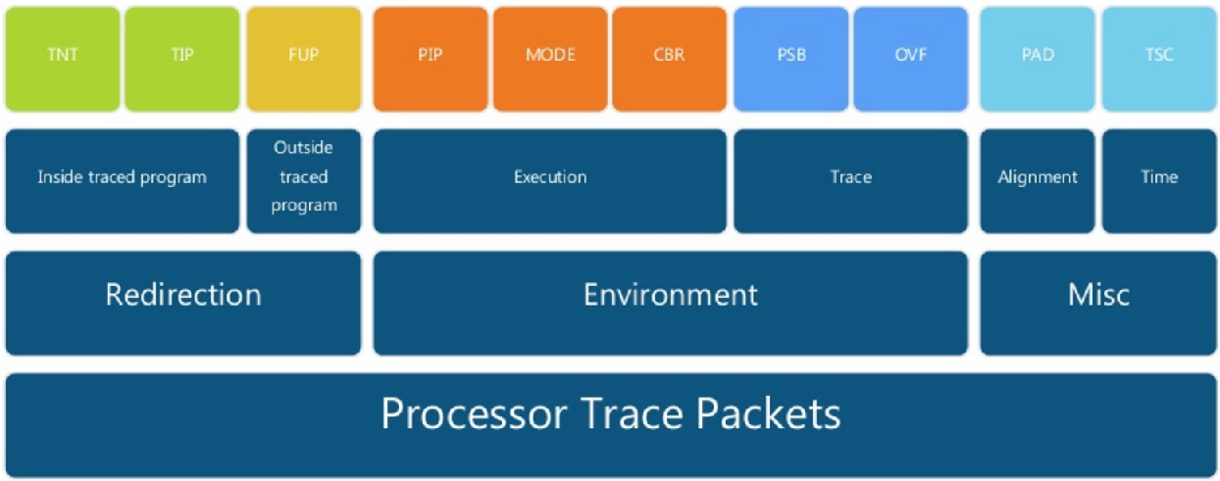
Intel Processor Trace
Complex log format - decode with opensource libipt library!
Notes:
taken / not taken
target ip
flow update
packet generation enable/disable
ringbuffer overflow
paging information packet
CR3 filtering

Slide 54
Intel Processor Trace (for programmers)
Packet Types
Packet Stream Boundary (PSB)
Heartbeat packet generated at regular intervals (configurable)
Paging Information (PIP)
Notifcation of CR3 Page Table changes
Timing (TSC, MTC & CYC)
Useful for wall-clock comparisons or synchronization of logs across CPU threads
Control Flow (TNT, TIP, FUP)
TNT – Taken/Not-Taken for conditional branches
TIP – Taken IP address for indirect branches
FUP – Flow Update

Slide 55
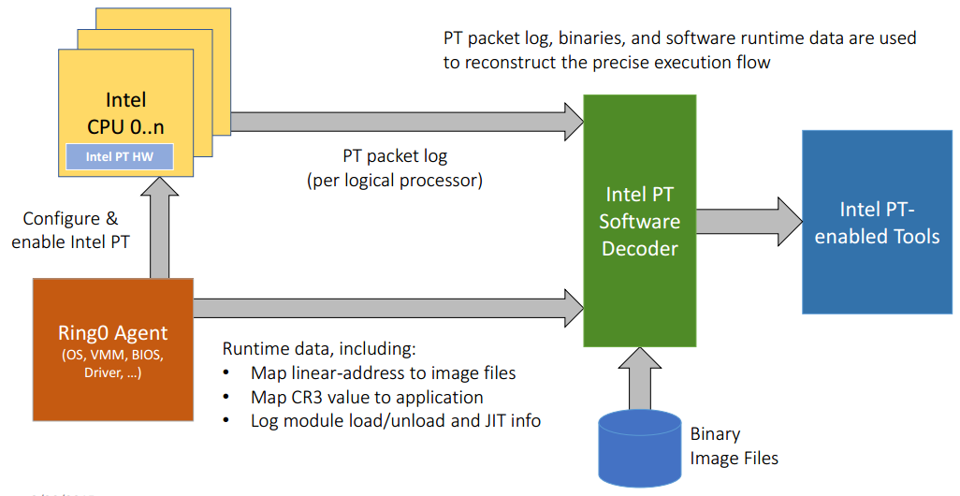
Intel Processor Trace

Slide 56
Intel Processor Trace
How to use: Linux perf tools (apt: linux-tools-common)
$ perf list | grep intel_pt
intel_pt// [Kernel PMU event]
$ perf record -e intel_pt//u date
Sun Oct 11 11:35:07 EDT 2015
[ perf record: Woken up 1 times to write data ]
[ perf record: Captured and wrote 0.027 MB perf.data ]
$ perf report
...
# Samples: 1 of event 'instructions:u'
# Event count (approx.): 157207
#
# Overhead Command Shared Object Symbol
# ........ ....... ............. ..........................
#
100.00% date libc-2.21.so [.] _nl_intern_locale_data
|
---_nl_intern_locale_data
_nl_load_locale_from_archive
_nl_find_locale
setlocale
...

Slide 57
Intel Processor Trace
How to use: simple-pt reference driver
% sptcmd -c tcall taskset -c 0 ./tcall
cpu 0 offset 1027688, 1003 KB, writing to ptout.0
...
Wrote sideband to ptout.sideband
% sptdecode --sideband ptout.sideband --pt ptout.0 | less
TIME DELTA INSNs OPERATION
frequency 32
0 [+0] [+ 1] _dl_aux_init+436
[+ 6] __libc_start_main+455 -> _dl_discover_osversio
n
...
[+ 13] __libc_start_main+446 -> main
[+ 9] main+22 -> f1
[+ 4] f1+9 -> f2
[+ 2] f1+19 -> f2
[+ 5] main+22 -> f1
[+ 4] f1+9 -> f2
[+ 2] f1+19 -> f2
[+ 5] main+22 -> f1
...

Slide 58
Intel Processor Trace
Talos IntelPT driver
struct PER_PROCESSOR_PT_DATA {
LPVOID lpTraceBuffVa; // + 0x00 - VA Pointer to a contiguous memory buffer
ULONG_PTR lpTraceBuffPhysAddr; // + 0x08 - The physical address of the contiguous memory buffer
DWORD dwBuffSize; // + 0x10 - The physical buffer size
ULONG_PTR lpTargetProcCr3; // + 0x18 - The process to monitor CR3
};

Slide 59
Intel Processor Trace
Talos IntelPT driver
struct INTEL_PT_CAPABILITIES {
BOOLEAN bCr3Filtering : 1; // [0] - CR3 Filtering Support (Indicates that
// IA32_RTIT_CTL.CR3Filter can be set to 1)
BOOLEAN bConfPsbAndCycSupported : 1; // [1] - Configurable PSB and Cycle-Accurate Mode
BOOLEAN bIpFiltering : 1; // [2] - IP Filtering and TraceStop supported, and
// Preserve Intel PT MSRs across warm reset
BOOLEAN bMtcSupport : 1; // [3] - IA32_RTIT_CTL.MTCEn can be set to 1, and MTC
// packets will be generated (section 36.2.5)
BOOLEAN bTopaOutput : 1; // [4] - Utilize the ToPA output scheme
BOOLEAN bTopaMultipleEntries : 1; // [5] - ToPA tables maximum allowed (MaskOrTableOffset)
...

Slide 60
Intel Processor Trace
Talos IntelPT driver
BOOLEAN bSingleRangeSupport : 1; // [6] - Single-Range Output Supported
BOOLEAN bTransportOutputSupport : 1; // [7] - Output to Trace Transport Subsystem Supported
// (Setting IA32_RTIT_CTL.FabricEn to 1 is supported)
BOOLEAN bIpPcksAreLip : 1; // [8] - IP Payloads are LIP
BYTE numOfAddrRanges; // + 0x01 - Number of Address Ranges
SHORT mtcPeriodBmp; // + 0x02 - Bitmap of supported MTC Period Encodings
SHORT cycThresholdBmp; // + 0x04 - Bitmap of supported Cycle Threshold values
SHORT psbFreqBmp; // + 0x06 - Bitmap of supported Configurable PSB Frequency encoding
};

Slide 61
Intel Processor Trace
Talos IntelPT driver
// Write the target CR3 value
__writemsr(MSR_IA32_RTIT_CR3_MATCH, targetCr3);
// Start tracing:
rtitCtlDesc.Fields.CR3Filter = 1;
rtitCtlDesc.Fields.FabricEn = 0;
rtitCtlDesc.Fields.Os = 0;
rtitCtlDesc.Fields.User = 1; // Trace the user mode process
rtitCtlDesc.Fields.ToPA = 0; // We use the single-range output scheme
rtitCtlDesc.Fields.BranchEn = 1;
//if (ptCap.bMtcSupport) {
// rtitCtlDesc.Fields.MTCEn = 1;
// rtitCtlDesc.Fields.MTCFreq = 10;
//}
rtitCtlDesc.Fields.TSCEn = 1;
rtitCtlDesc.Fields.TraceEn = 1; // Switch the tracing to ON dude :-)
__writemsr(MSR_IA32_RTIT_CTL, rtitCtlDesc.All);

Slide 62
Intel Processor Trace
Talos IntelPT driver
C:\code\intelpt>instdrv.exe /I windowsptdriver.sys
C:\code\intelpt>testintelpt.exe c:\windows\system32\notepad.exe
C:\code\intelpt>..\libipt\ptdump pt_dump.bin | findstr /V pad | more
00000000000006e8 psb
00000000000006fe tsc 4e1ef46cbc
0000000000000708 cbr 1f
000000000000070c psbend
0000000000000716 tsc 4e1ef8afb9
. . .
0000000000000ce0 cbr 1c
0000000000000cf0 tip 2: ????????4d515400
0000000000000cf5 tnt.8 ..!
0000000000000cf8 tip 2: ????????4bb10ca0
0000000000000cfd tnt.8 !!....
0000000000000cfe tnt.8 !
0000000000000d00 tip 2: ????????4d515400
0000000000000d05 tnt.8 ..!
0000000000000d08 tip 2: ????????1a91e4f0
0000000000000d0d tnt.8 !!!!!!

Slide 63
Outro

Slide 64
Conclusion
Evoloutionary algorithms have a lot to offer for automation
https://github.com/talos-vulndev/
Initial investment in development pays dividends
Use correct engine for long term deployment
Designing tracing engines is not for everyone
Hardware tracing is approaching software performance
This code is opensource software
https://github.com/talos-vulndev/
`

Slide 65
Thank You!

Slide 66
@richinseattle
rjohnson@moflow.org

